Slide 1
Programming basics
Intro to the command line

Slide 2
Purpose of Today’s Class
In today’s class we learn about command line environments, getting started with GitHub, and basic programming logic.

Slide 3
What we will Accomplish Today
We will create our own GitHub profile
Learn about the basics of a command line environment
We will use cloud9 to play around with our Linux environment
Learn some core programming concepts
Write our first program
Run our first program
Add our files to GitHub
Learn how to set up our own environment on our home machine

Slide 4

Today We Will Learn How Learn to Code

Slide 5
Why Code?
“I think everyone should get a little exposure to computer science because it really forces you to think in a slightly different way, and it’s a skill that you can apply in life in general, whether you end up in computer science or not” - Tony Hsieh
“Software touches all of these different things you use, and tech companies are revolutionizing all different areas of the world...from how we shop to how farming works, all these things that aren't technical are being turned upside down by software. So being able to play in that universe really makes a difference” - Drew Houston
“Coding is today’s language of creativity. All our children deserve a chance to become creators instead consumers of computer science” - Maria Klawe

Slide 6
What do you wish you knew before you got started coding?
“Be more fearless and break your computer. You learn the most in the debugging” – Tanya Tarr
“Learning a new pattern is much more valuable than a new language” – Travis Hoppe
“Even the most experienced Developers utilize a lot of trial and error. Struggling through code and asking google is natural” – Nicholas Marcouiller

Slide 7

My Story

Slide 8
Introductions
Name
Favorite movie
What brings you here today

Slide 9
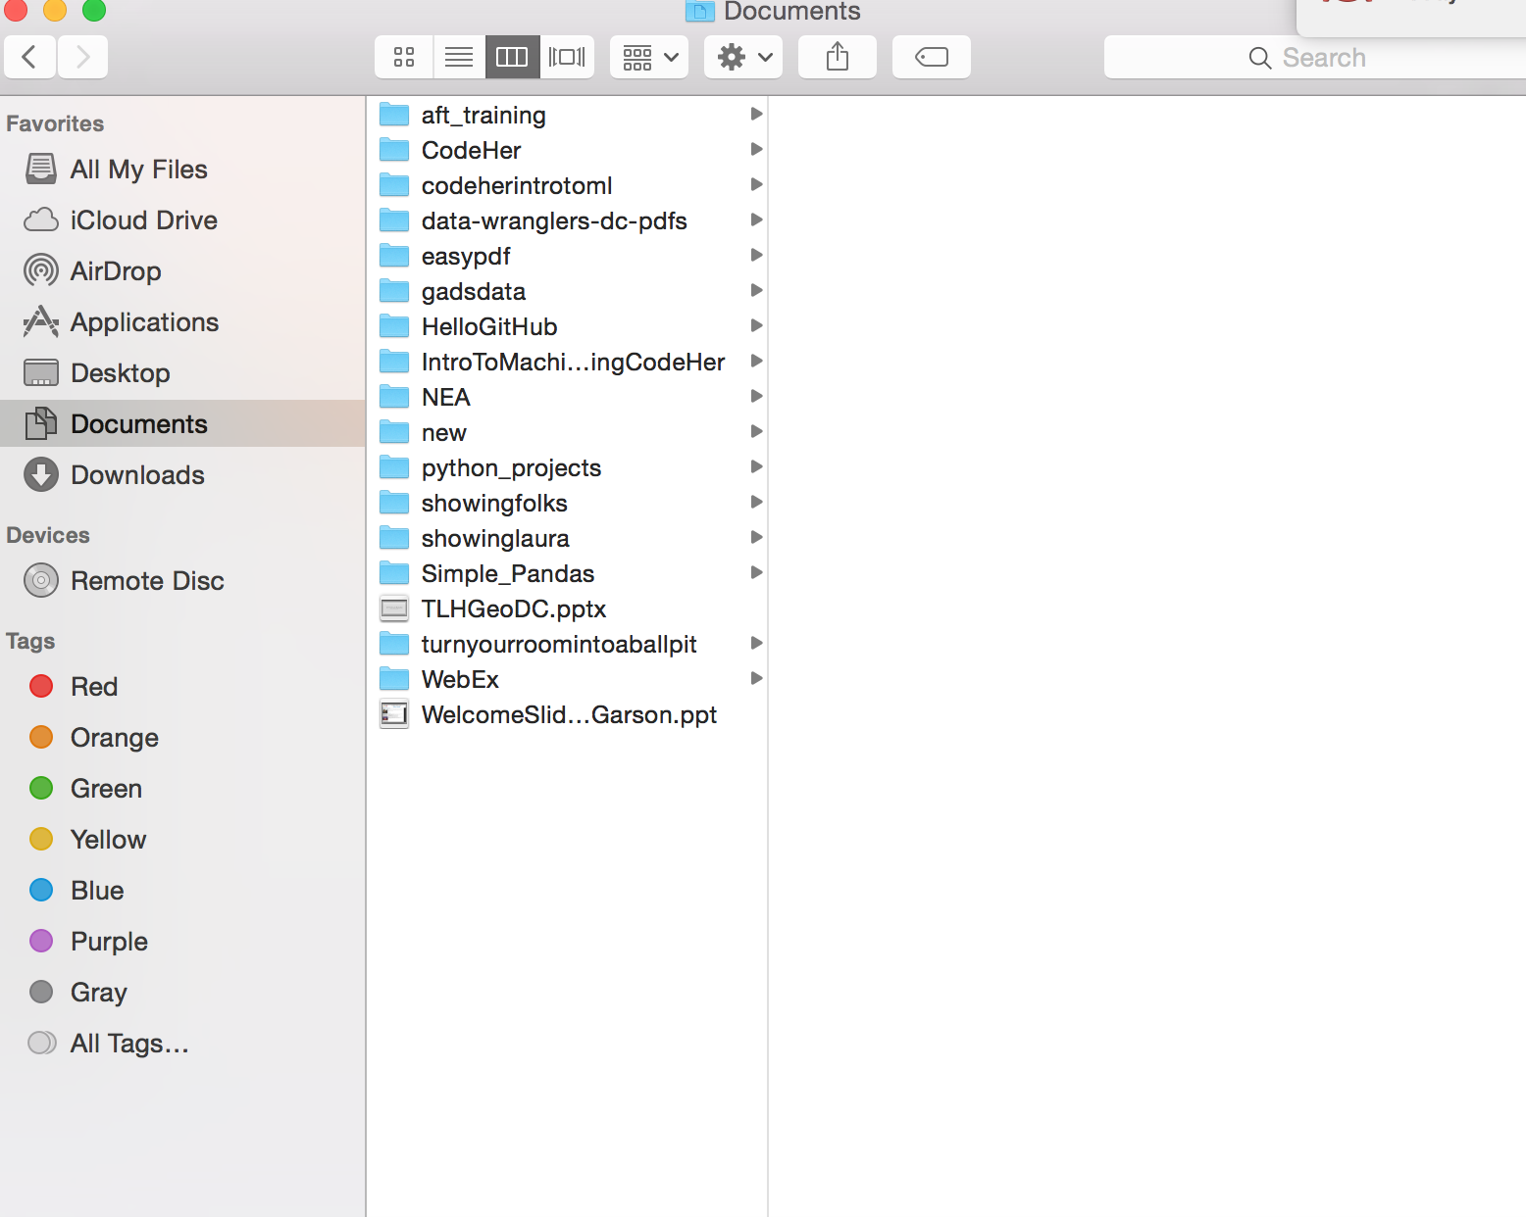
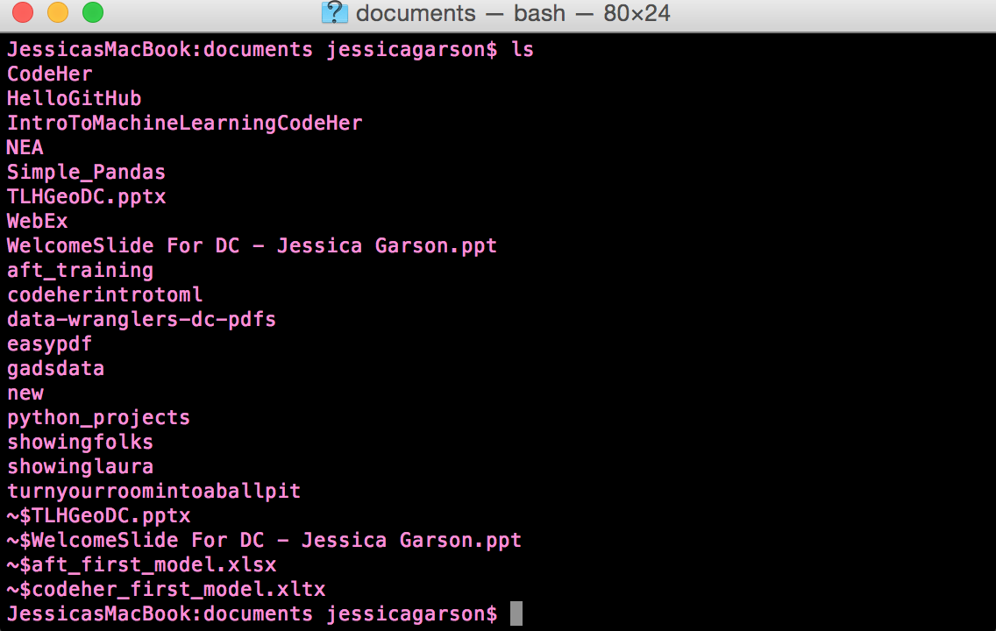
What is the command line?
The command line is a way of interacting with the computer but without the graphical interface we are used to in programs using finder on the computer

Slide 10


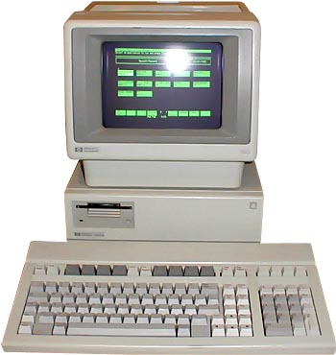
Linux, Unix and Other Systems

Slide 11


Git vs Github

Slide 12

What is Open Source software?

Slide 13
A few other key terms
Bash scripting - A script for a computer tells the computer what it should do or say. In the context of Bash scripts we are telling the Bash shell what it should do. A Bash script is a plain text file which contains a series of commands.
Shell - A shell is a program that provides the traditional, text-only user interface for Linux and other Unix-like operating systems.

Slide 14
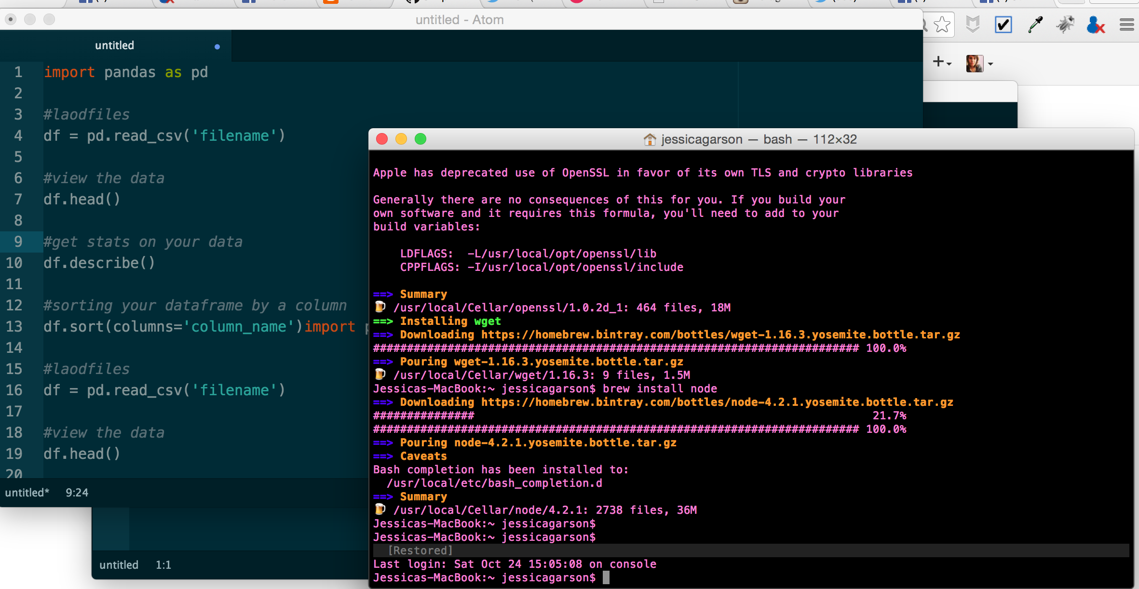
What do you need to code?

Slide 15
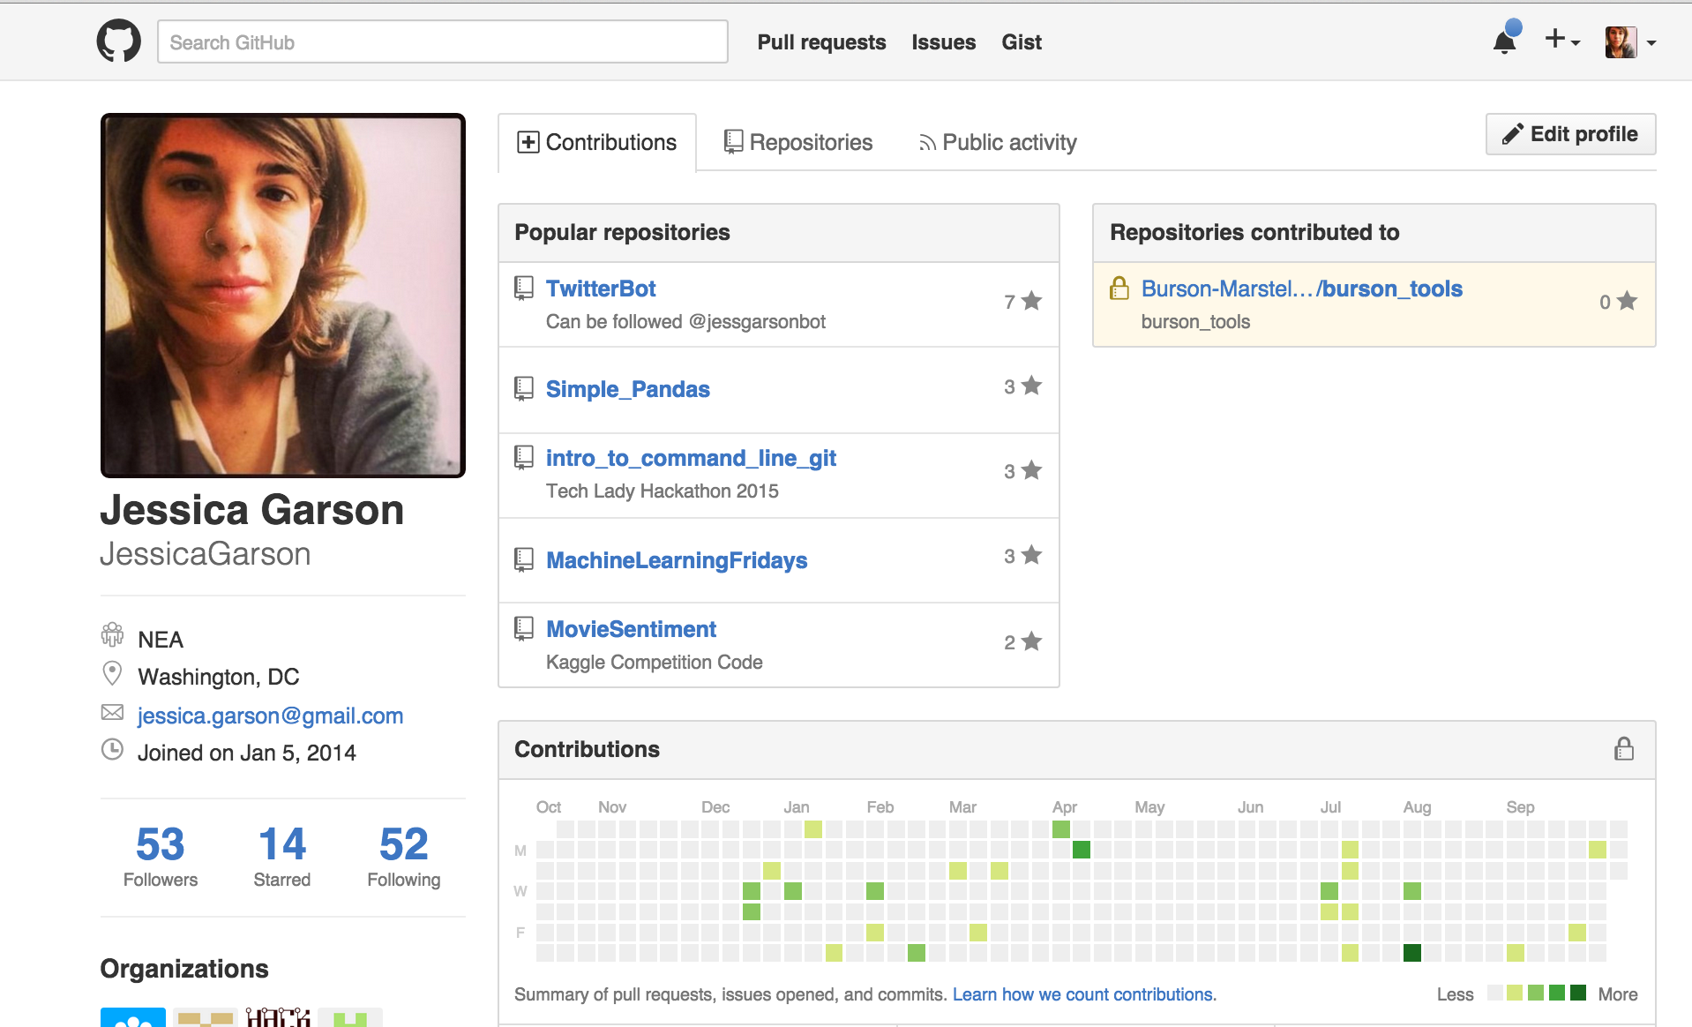
Let’s make our own GitHub profile www.github.com

Slide 16
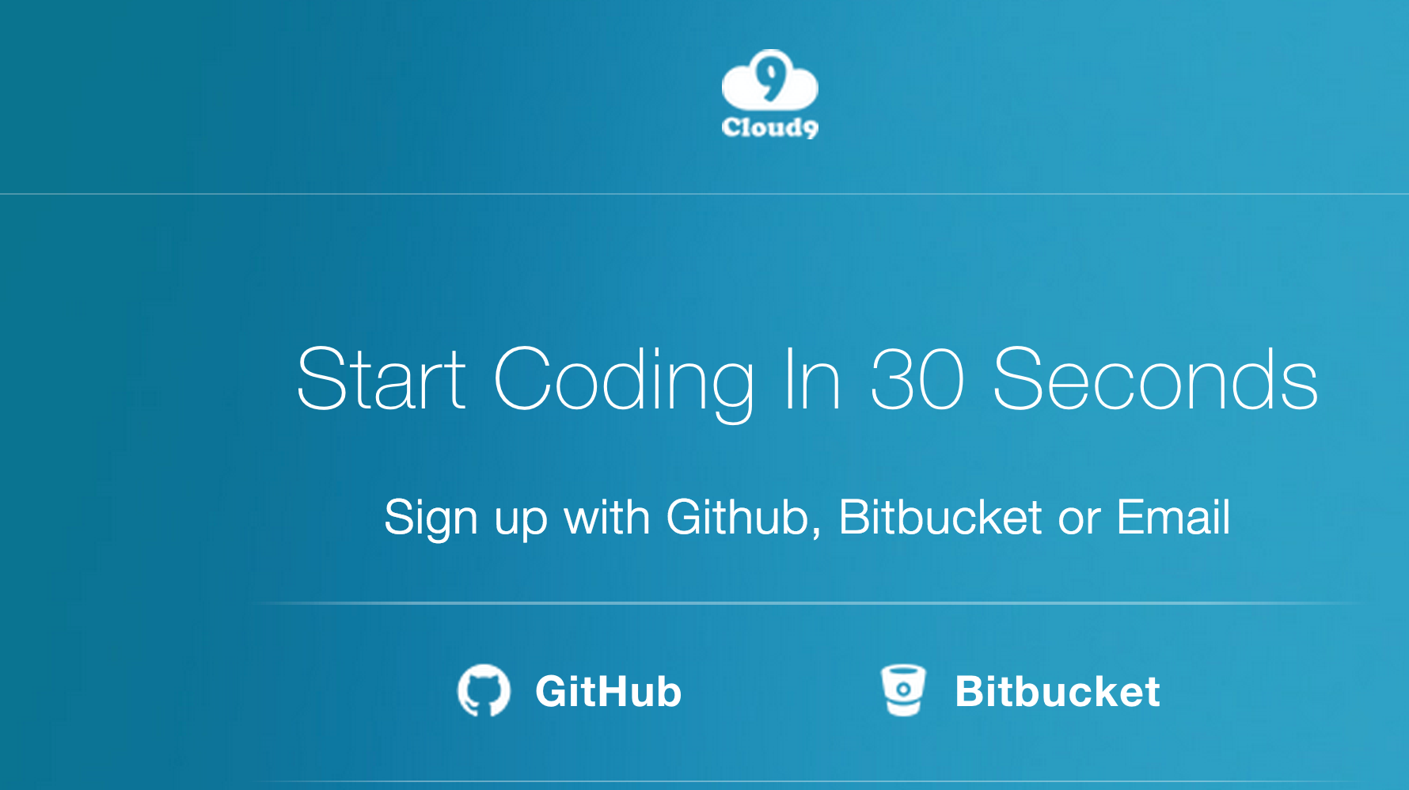
Let’s Create Our Cloud 9 account https://c9.io/web/sign-up/free

Slide 17
Activity – 20 Questions
Let’s as a class play a game
If you don’t remember how to play 20 questions here is a quick recap:
One person thinks of an object and the other player gets to guess up to 20 questions to guess the object

Slide 18
Debrief
What logic did you use to help make a guess?
What strategies were effective?
What strategies proved ineffective?

Slide 19
Computer Concepts We Used
Computational thinking
Linear search
Binary search
Divide and conquer
Comparing algorithms
Notes:
In computer science, a binary search or half-interval search algorithm finds the position of a target value within a sorted array.
In computer science, linear search or sequential search is a method for finding a particular value in a list that checks each element in sequence until the desired element is found or the list is exhausted.

Slide 20
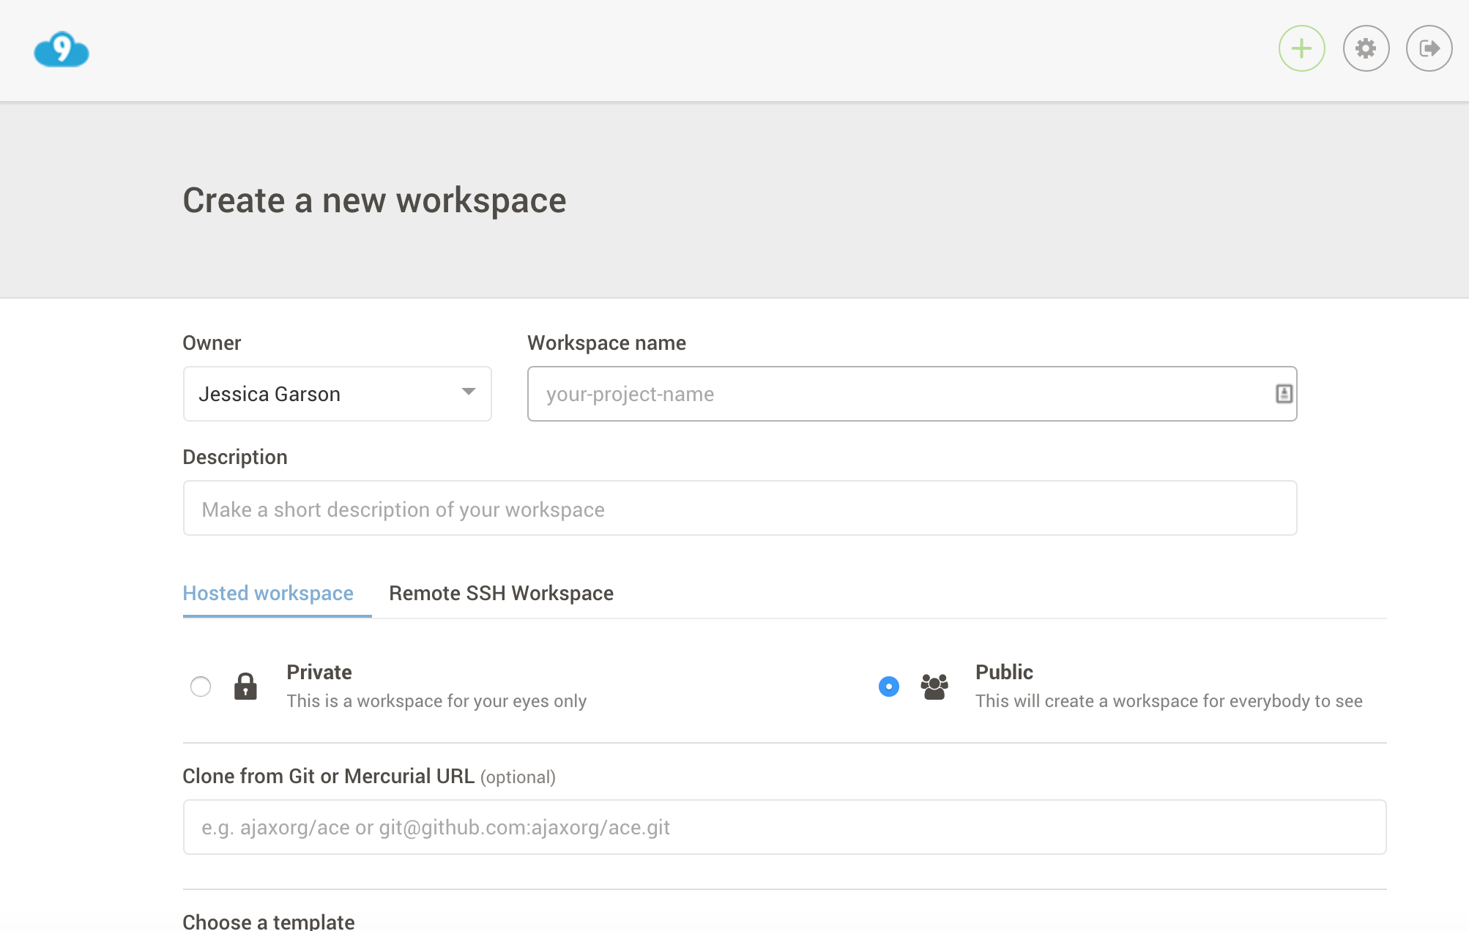
Setting Up in Cloud 9

Slide 21
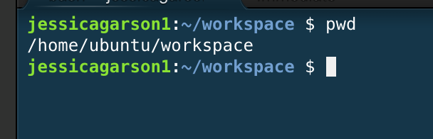
Where am I? pwd

Slide 22
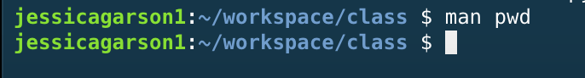
Show the manual page for a command man

Slide 23
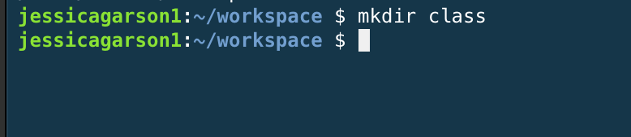
Make a new directory mkdir

Slide 24
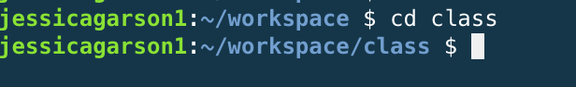
Change Directory cd directory_name

Slide 25
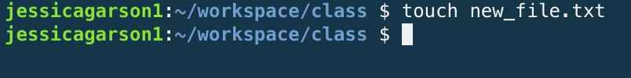
Make new file touch file_name

Slide 26
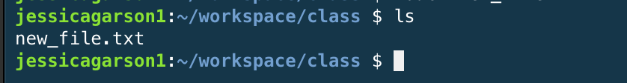
List contents of a directory ls

Slide 27
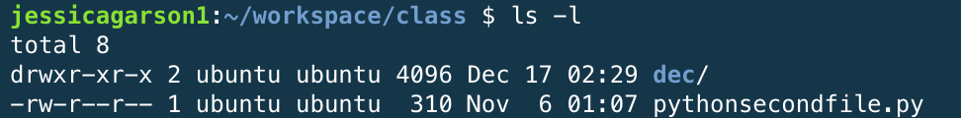
List the longer contents of a directory ls –l

Slide 28
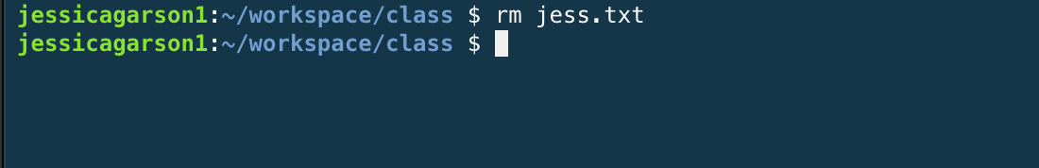
Remove a File rm

Slide 29
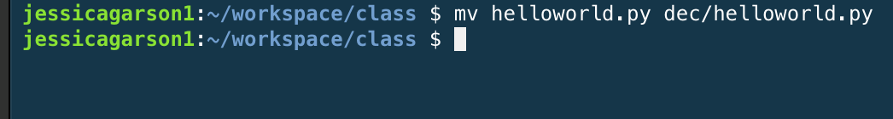
Move a file mv

Slide 30
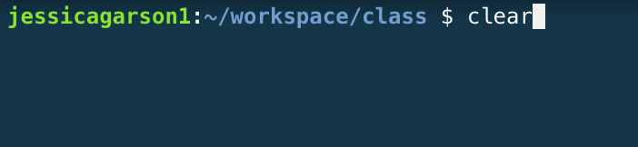
Clear the contents of command line window clear

Slide 31
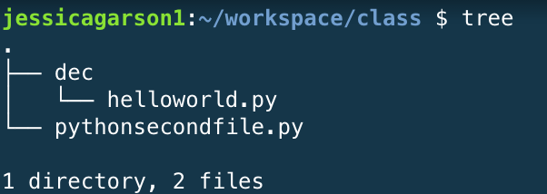
Create a tree diagram of contents Tree

Slide 32
Remove a directory rm –r directoryname

Slide 33
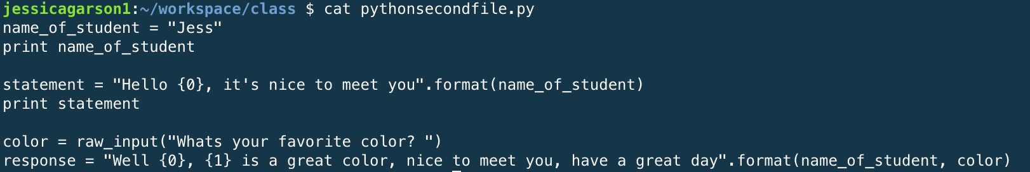
Read a file cat

Slide 34
Tells you how many lines, words and characters there are in a file wc

Slide 35
A few tricks
Tab complete
The up arrow
The down arrow

Slide 36
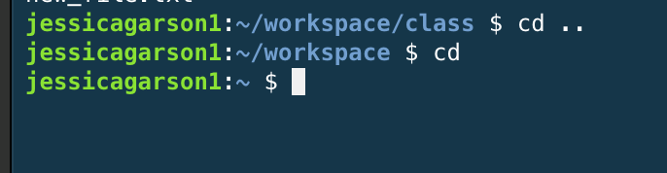
Some key commands for changing directories

Slide 37
Let’s Play Around On The Command Line
Let’s take a few minutes to create a few files, move some files and generally play around to get to know the command line.

Slide 38

Our First Python Program

Slide 39
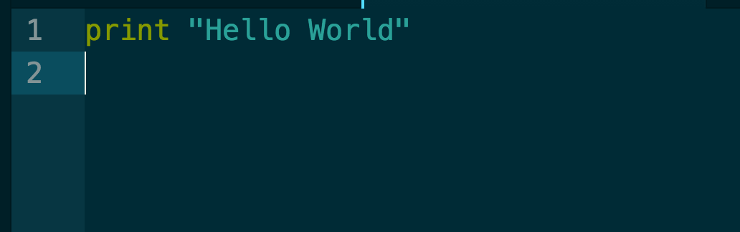
Our First Python Program

Slide 40
Running our first program

Slide 41
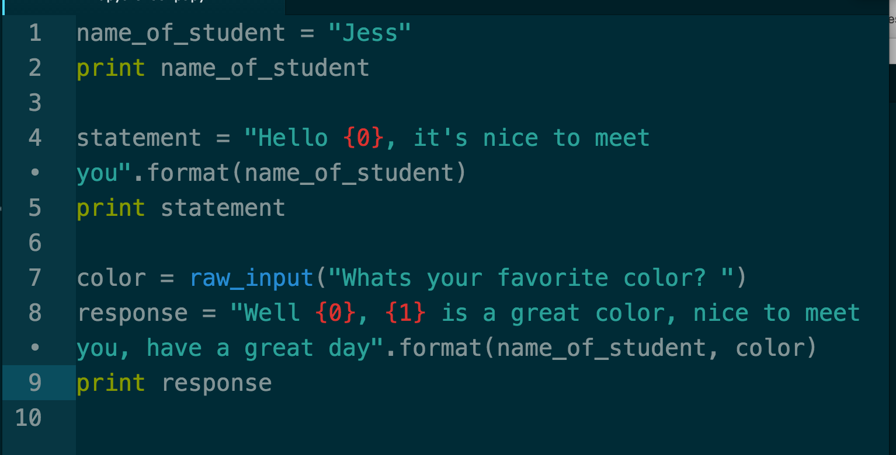
Our 2nd Python Program

Slide 42
Let’s play and around and adjust the 2nd program
Make changes a you see fit
Run the program when you are ready
Let me know if you have any questions

Slide 43
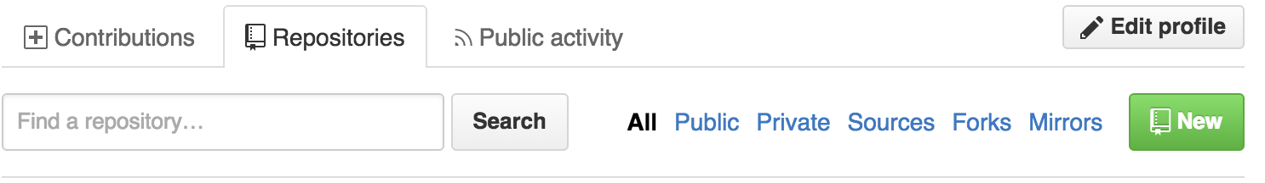
Let’s add our files to github

Slide 44
Do This at Home
Shell Environments
On a mac – there is a Linux environment that comes pre-installed called the terminal
To get to the terminal go to finder select utilities and inside the folder you should
On a PC – There are many options but I really like babun - http://babun.github.io/
Text Editors
Sublime Text - http://www.sublimetext.com/
Atom - https://atom.io/
Notepad ++ for PC only - https://notepad-plus-plus.org/

Slide 45






The coolest thing about DC right now

Slide 46

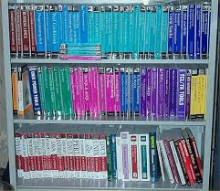
What Resources Does The Library Offer?

Slide 47
Other Classes in this Series

Slide 48
Resources for Learning How to Code
What have you tried?
What’s worked well for you?
What hasn’t worked for you?
What can we try?

Slide 49
Questions, Comments, Feedback
Let us know if you have any

Slide 50
Contact
Jessica Garson
Jessica.Garson@gmail.com
Jessica.Garson@bm.com
Twitter: @jessicagarson

